Slide 1

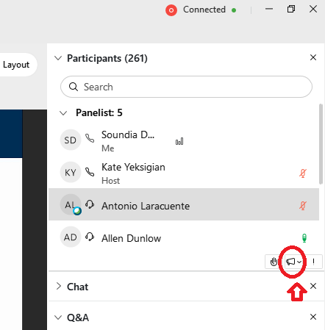
Webinar
Housekeeping
Dial in: 1 – 404 – 397 – 1596
Access Code: 2763 - 699 - 8787
Slides in “Handout” Tab
We would be ever so grateful if you would complete the post-webinar evaluation survey that pops up once you exit the webinar.
Experiencing sound issues – you can call in using the number included on the handouts and on your registration confirmation email that you received.
Handouts were sent out in advance to those that registered for the webinar…by the time we sent the handouts out.
  Check the Q&A box for the link to the SharePoint site where you will be able to download the handouts.
Please use the Q&A feature to submit questions.
  Please do not use Chat to send in questions.
  Be sure to send questions to “All panelists”.
Be heard! Use the gramophone found at the bottom of the participant list to give us feedback during the webinar

Slide 2
OIS RSD VHA Regulatory Research Cybersecurity Guidance Request Process & Intake Portal Role-Base research stakeholder tRAINING
Dial in: 1 – 404 – 397 – 1596
Access Code: 2763 - 699 - 8787
Slides in “Handout” Tab
DuJuan Williams, Carol Johnson, Terry Peters
OIS-SSS-Research Support Division (RSD)
October 8, 2021

Slide 3


Mission and Vision
Mission:
The Office of Information Security (OIS), Research Support Division (RSD) provides stakeholders across the VA enterprise participating in Research & Development (R&D) programs and facilities with guidance in complying with research information security policy.
Vision:
Ensuring information & cybersecurity is an enabler for VHA Research & Development’s business considerations and objectives of VHA stakeholders.​

Slide 4

Objectives
OIS RSD VHA Regulatory Research Cybersecurity Guidance Request Process & Intake Portal include the following:
  To establish a primary resource for stakeholders and customers requesting research information and cybersecurity support services through the development of the OIS VHA Regulatory Research Cybersecurity Guidance Request Process & Intake Portal.
  To streamline the process for triaging, evaluating, and responding to research stakeholder’s request for information and guidance regarding a research project’s compliance with VHA/VA regulations, directives, and cybersecurity/information security policies through the VHA Regulatory Research Cybersecurity Guidance ServiceNow Catalog.
  To Increase awareness of processes that help address research-specific information security needs and requirements

Slide 5




Business and Security Drivers | Benefits
Aligns with OIS Mission to prioritize the development of​ enterprise cyber​security processes and the adopt secure technologies that align with the business considerations and objectives of VHA stakeholders.​
Enables information security teams to identify, evaluate, and provide recommendations to unique research regulatory information security requirements in accordance with VHA/VA regulations, directives, and cybersecurity/information security policies.
Provides a consistent, standardized, customer facing solution for research stakeholders to submit requests for enterprise level guidance and consultation on essential research information & cybersecurity services for stakeholders participating in a Research & Development (R&D) program at their local facility.
Promotes increased education & awareness to the research community for improved security posture of the research & development (R&D) operational environment. Ability to expedite information security guidance requests for research projects
Avoid delays in security assessment reviews by ensuring all relevant information is collected at the time of the request for guidance/consultation
Address identified noncompliance and risk mitigation requirements within the 2018 ORD/ORO VHA Research Information Security Vulnerabilities Memorandum

Slide 6
Targeted Stakeholders/Customers
Key stakeholders include those managing the security posture of a research program including, but not limited to:
  Information System Security Managers (ISSMs)
  Principal Investigators (PIs)
  Information System Security Officers (ISSOs)
  Research Staff
  Associate Chief of Staff/Research and Development (ACOS/R&D)
  Institutional Review Board (IRB)/R&D Committee Members
  Other collaborators include:
  Office of Research & Oversight (ORO)
  OIT ITOPS
  Office of General Counsel (OGC)
  Office of Research & Development (ORD)
  Office of Research Protections, Policy, and Education (ORPP&E)
  VHA Privacy
  Enterprise Security Operations (ESO)

Slide 7

Key Collaborators
ORO
OGC
ACOS/R&D
ORD
Principal Investigator (PI)
ORPP&E
Approved
ISSO
OIT ITOPS

Slide 8
Poll Questions!

Slide 9
Poll Question 1
Select the primary benefit(s) of the new OIS RSD VHA Regulatory Research Cybersecurity Guidance Request Process & Intake Portal
Please answer the poll question when it appears on the right-hand side of your screen.
Then click the “Submit” button located in the lower right-hand corner

Slide 10
ANSWER
Establish a primary resource for stakeholders and customers requesting research information and cybersecurity support services
Streamline the process for triaging, evaluating, and responding to research stakeholder’s request
Increase awareness of processes that help address research-specific information security needs and requirements
All of the Above

Slide 11
Poll Question 2
Select who will NOT benefit from the new OIS RSD VHA Regulatory Research Cybersecurity Guidance Request Process & Intake Portal (check all that apply)
Please answer the poll question when it appears on the right-hand side of your screen.
Then click the “Submit” button located in the lower right-hand corner

Slide 12
ANSWER
Information System Security Officers/Managers (ISSO/ISSM)
Non-research programs (Clinical)
Area Managers
Institutional Review Board (IRB)/R&D Committee Members
Principal Investigators (PI)

Slide 13
Request Service Types
Policy Guidance
Protocol Security Consultation/Review
Cybersecurity/Information Security Policy Guidance
Request for services related to the general policy related guidance (i.e Security Control Requirements, Software Compliance, Approved Technologies, Research Devices/Equipment, Mobile & Collaborative Technologies, Policy Compliance or other general requests)
Electronic Data Transmission Review
1. Policy Guidance
Research Study/Protocol/Clinical Trial Information Security Consultation/Review
Request for services related to the security considerations during the planning, design & post-approval phases of a research study/protocol/clinical trial and applicability of the Enterprise Research Data
Security Plan (ERDSP)
Research Agreement Review
Electronic Data Transmission Review
Request for services related to the security review of a collaborative or clinical trial sponsor’s electronic case report form (eCRF), electronic data capture (eDC) system, or website
Research Agreement Review
Request for services related to the security review of a VHA Research Data Use Agreement (DUA) or contract (i.e. 6500.6 Checklist)

Slide 14
Use Cases | Cybersecurity/Information Policy Guidance
Policy Guidance
Cybersecurity/Information Security Policy Guidance
Request for services related to general policy related guidance (i.e. Security Control Requirements, Software Compliance, Approved Technologies, Research Devices/Equipment, Mobile & Collaborative Technologies, Policy Compliance or other general requests)
VHA Regulatory Research Cybersecurity Guidance - VA ServicePortal v2
Use Case#1: Researcher will be loaning iPads to research participants without smart devices to use mobile applications to track sleep patterns. Researcher is not sure if how to obtain approval for mobile application.
Action: Researcher/ISSO submits request for policy guidance related to the approval/use of mobile applications within the VHA Regulatory Research Cybersecurity Guidance ServiceNow Catalog.
Use Case #2: Research study will be sharing research data with research collaborator and wonders what security considerations should be considered when transferring data to collaborator.
Action: Researcher/ISSO submits request within the VHA Regulatory Research Cybersecurity Guidance ServiceNow Catalog for data protection policy guidance when data is leaving the protected boundary of the VA

Slide 15
Use Cases | Security Consultation/Review
Protocol Security Consultation/Review
Research Study/Protocol/Clinical Trial Information Security Consultation/Review
Request for services related to security considerations during the planning, design & post-approval phases of a research study/protocol/clinical trial and applicability of the Enterprise Research Data
Security Plan (ERDSP)
VHA Regulatory Research Cybersecurity Guidance - VA ServicePortal v2
Use Case#1: Researcher is conducting a retrospective study and wonders if an ERDSP is required.
Action: Researcher/ISSO submits request within the VHA Regulatory Research Cybersecurity Guidance ServiceNow Catalog for research study protocol security consultation.
Use Case #2: Researcher is unsure of data classification levels for data being collected during research study.
Action: Researcher/ISSO submits request within the VHA Regulatory Research Cybersecurity Guidance ServiceNow Catalog to assess data classification used in the research study.

Slide 16
Use Cases | Electronic Data Transmission Review
Electronic Data Transmission Review
Electronic Data Transmission Review
Request for services related to the security review of a collaborative or clinical trial sponsor’s electronic case report form (eCRF), electronic data capture (eDC) system, or website
VHA Regulatory Research Cybersecurity Guidance - VA ServicePortal v2
Use Case#1: Researcher will be participating in clinical trial using the sponsors eDC system and is unsure if system is approved for use at the VA for research.
Action: Researcher/ISSO submits request within the VHA Regulatory Research Cybersecurity Guidance ServiceNow Catalog for research consultation regarding use of the electronic data capture system for use in VA research.

Slide 17
Use Cases | Research Agreement Review
Research Agreement Review
Cybersecurity/Information Security Policy Guidance
Research Agreement Review
Request for services related to the security review of a VHA Research Data Use Agreement (DUA) or contract (6500.6 Checklist)
VHA Regulatory Research Cybersecurity Guidance - VA ServicePortal v2
Use Case#1: A researcher requests assistance with determining if a DUA is the appropriate agreement for VA data being collected, processed and stored on an external information system.
Action: Researcher/ISSO submits request to RSD for research guidance to obtain assistance in determining if a DUA is appropriate in this case for the collection, processing or storing of VA data on an external information system.

Slide 18
Poll Questions!

Slide 19
Poll Question 3
Select the platform used for the new OIS RSD VHA Regulatory Research Cybersecurity Guidance Request Process & Intake Portal
Please answer the poll question when it appears on the right-hand side of your screen.
Then click the “Submit” button located in the lower right-hand corner

Slide 20
ANSWER
Technical Reference Model (TRM)
ServiceNow (YourIT)
VA IT Process Request (VIPR)
None of the Above

Slide 21
Poll Question 4
What request types are available on the new OIS RSD VHA Regulatory Research Cybersecurity Guidance Request Process & Intake Portal?
Please answer the poll question when it appears on the right-hand side of your screen.
Then click the “Submit” button located in the lower right-hand corner

Slide 22
ANSWER
Cybersecurity/Information Security Policy Guidance
Research Study/Protocol/Clinical Trial Information Security Consultation/Review
Electronic Data Transmission Review
Research Agreement Review
All of the above

Slide 23
Process Workflow (SLA)

Slide 24
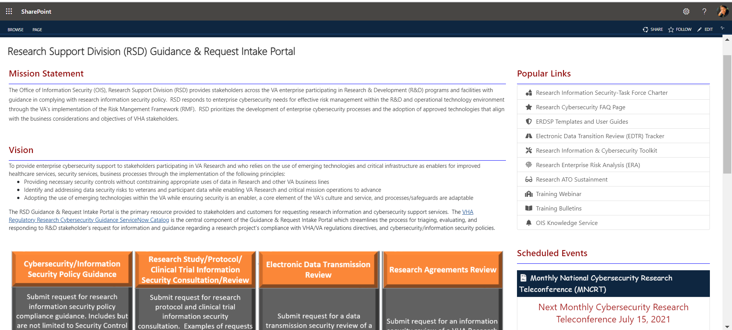
DEMO: OIS RSD SharePoint Portal
Research Support Division (RSD) Guidance & Request Intake Portal​

Slide 25
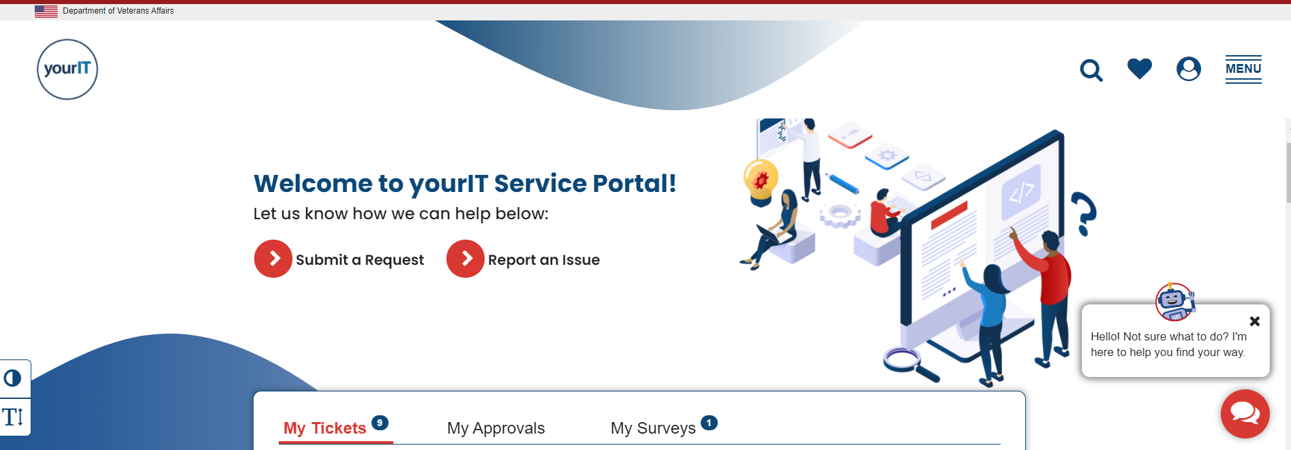
DEMO: ServiceNow Portal
https://yourit.va.gov/va

Slide 26
Frequently Asked Questions (FAQ)
When is the best time to submit a request within the OIS RSD VHA Regulatory Research Cybersecurity Guidance Request Process?
During the conceptual and/or planning phases of the research project.
Does this process replace facility ISSO services?
No, however your local ISSO will continue to be your initial point of contact. The intake process is meant to compliment your local ISSO support.
Does this process replace the ERA ServiceNow Process?
No. Please continue using the existing ServiceNow ERA process regarding the connection of Research Scientific Computing Devices (RSCD) to the VA network.
How is this process different from other intake processes (i.e., VIPR)?
This process primarily offers support to research stakeholders that require unique research regulatory information security/cybersecurity guidance and consultation.
Does the Cybersecurity/Information Security Policy Guidance Request Type replace VAIRRS?
No. ERDSP will still be loaded to VAIRRS for ISSO reviews

Slide 27
Last Poll Question

Slide 28
Poll Question 5
Where can you go to find OIS RSD cybersecurity/information security resource links, RSD scheduled events and access to the new OIS RSD VHA Regulatory Research Cybersecurity Guidance Request Process & Intake Portal?
Please answer the poll question when it appears on the right-hand side of your screen.
Then click the “Submit” button located in the lower right-hand corner

Slide 29
ANSWER
ServiceNow (YourIT)
OIS Research Support Division (RSD) SharePoint Site
VA Innovation and Research Review System (VAIRRS)
None of the Above

Slide 30
References
OIS RSD VHA Regulatory Research Cybersecurity Guidance ServiceNow Catalog
Research Support Division (RSD) Guidance & Request Intake Portal​
Research Cybersecurity FAQ​
RSD Electronic Data Transmission Review​
ORD VA Innovation and Research Review System (VAIRRS) Resources
​VAIRRS Portal
Research Support Division (RSD) Guidance & Request Intake Portal
Points of Contact​
Dujuan Williams DuJuan.Williams@va.gov
Carol Johnson Carol.Johnson31@va.gov
Terry Peters Terry.Peters@va.gov
Roland Sasaki Roland.Sasaki@va.gov
Brian Sharpless Brian.Sharpless@va.gov
RSD DL - OITITOPSSOESOResearchSupportDivision@va.gov

Slide 31
Availability of Recording
A recording of this session and the associated handouts will be available on ORPP&E’s Education and Training website approximately one-week post-webinar
An archive of this and other webinars can be found here: https://www.research.va.gov/programs/orppe/education/webinars/archives.cfm

Slide 32
Q&A
Please type any questions you may have in the Q&A box.
We will try to answer everyone’s questions before the close of the hour.

